Slide 1
FSE SSNoC Project
Presentation
SV-1 AlphaAxes
Bowen Yang, Uduak ‘Eren,
Shicheng Xu (Light), Yi Cao

Slide 2
Outline
Vision
Implemented Functionalities
Project Structure
Architecture Style & Layout
Design Patterns Used
Software Quality Attributes
Software Engineering Practices
Lessons Learned

Slide 3

Survivable Social Network on Chip

Slide 4

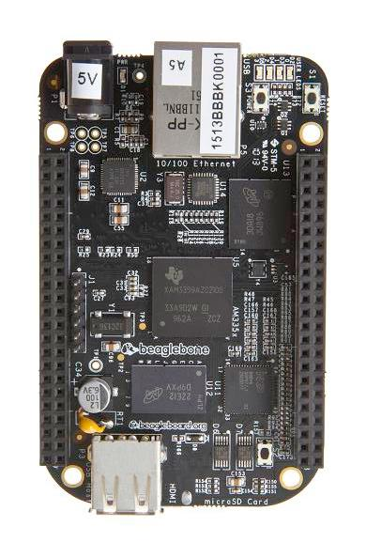
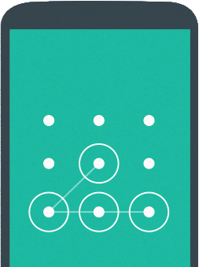
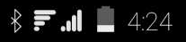
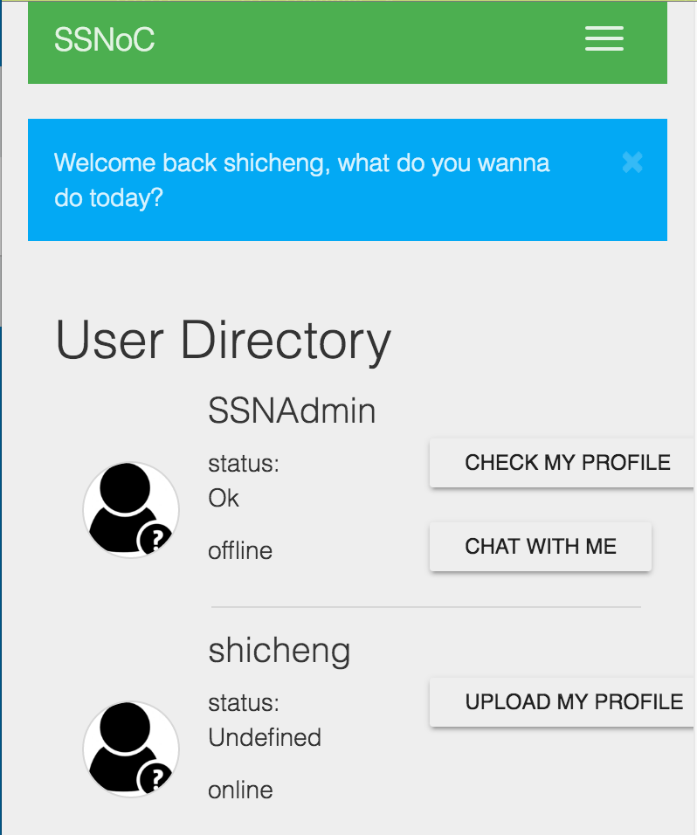
Vision

Slide 5
Implemented Functionalities
Commute Functionalities
Join Community
Chat Publicly
Chat Privately
Rescue Functionalities
Share Status
Post Announcement
Share Location

Slide 6
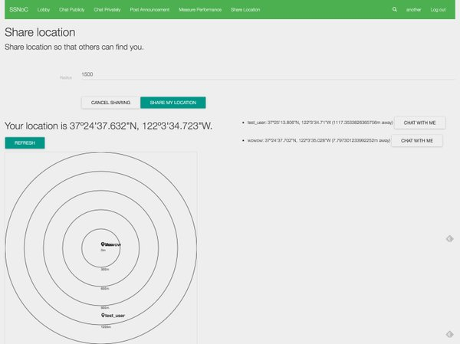
Share Location

Slide 7
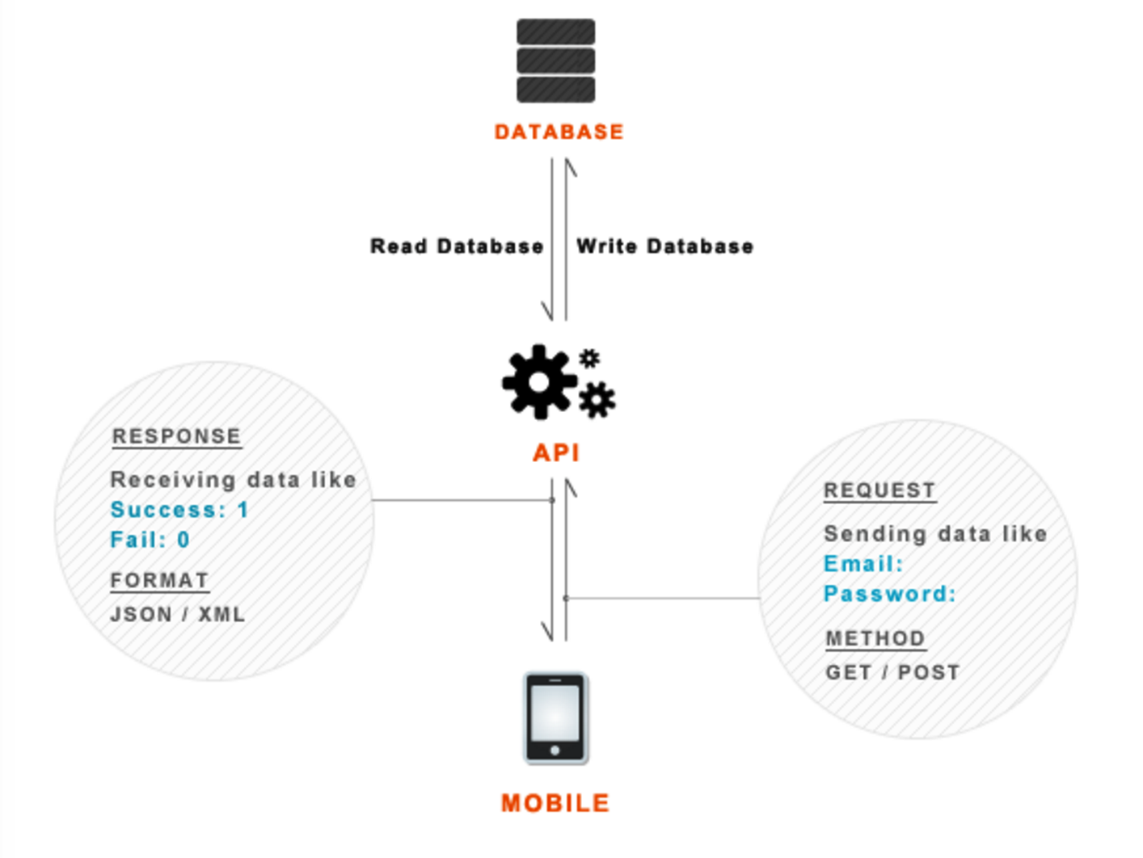
Architecture Style
Client-Server

Slide 8
Architecture Layout
Notes:
we design all jade templates and prepare resources for the front end web interfaces. After prepare jade templates and resources, we use angular controllers and services to provide all operations for the elements inside interfaces. I would mention that the angular services are used to bridge the communication between different interfaces. Like for the chat privately, we could use angular services to get those two users. And the angular controllers include all all http post and http get requests. With routers, we send the requests from the front-end to the backend. When the backend get the requests in its controllers, we call models to access those requests from users. Here according to OO, the models encapsulate all the properties and operations of an entity. And in the models, we call the db functions to process the data. Finally the controllers prepare all the response data for the front end. And then we display all those data in the interfaces.

Slide 9
Front-end
Main Libraries:
Angular.js
Bootstrap
Moment.js
Express.js
Socket.io
Sqlite3
Base64.js
Notes:
In the front-end, we first prepare layout templates for all view interface to extend. And we use controllers in different module to provide necessary function for all angular scopes. In the main.js file, we have RouterProvider and StateProvider for all nested views

Slide 10
Front-end
Main.js
stateProvider
urlRouterProvider
Main.js
app.config(function($stateProvider, $urlRouterProvider) { $urlRouterProvider.otherwise('/'); $stateProvider .state('home', { url: '/', templateUrl: 'partials/index.jade' }) .state('lobby', { url: '/lobby', templateUrl: 'partials/lobby.jade' }) .state('chatpublicly', { url: '/chatpublicly', templateUrl: 'partials/chatpublicly.jade' })
Notes:
In the app.config, here we have RouterProvider and StateProvider. it could support multiple views and each can have it’s own corresponding Controller so that each of these regions can be encapsulated and reused throughout the application if needed. With the angular ui router, our nested views can work. Besides, with angular UI-Routers, we introduce a state machine abstraction on top of a traditional router. Routes are referred to as states and the URL becomes simply a property of the state. In practice, $urlRouterProvider is there to establish a default route for URLs that don’t have a specific route. And the stateProvider is there to establish the monitor the states of URLs.

Slide 11
Backend
Notes:
In the backend, we could start from routers where collects all rest requests. Like we have userController and messageController to receive post and get requests. And in controllers, we call models’ operation to prepare all response data. Those data would be processed in dbTables where we have all tables and database functions. Once the data is prepared, we would send data back to controllers.

Slide 12

Design Patterns Used
Façade
Singleton
Adapter
Observer

Slide 13
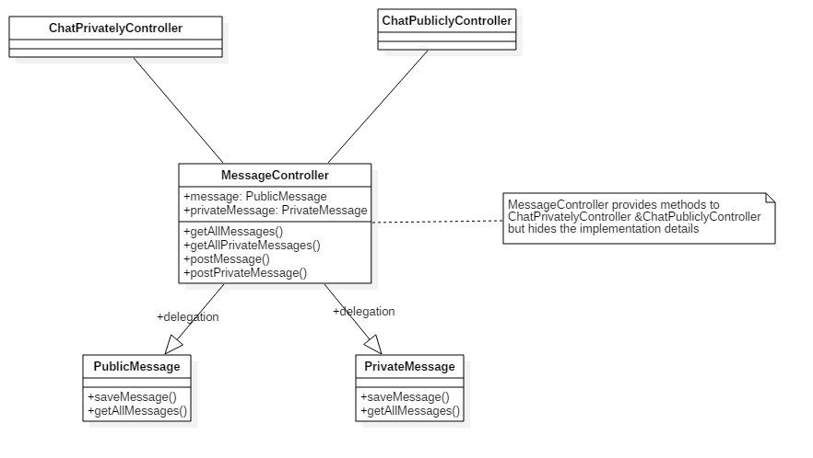
Design Implementation: Façade
>> Used mainly to hide implementation details of server-side and client controller methods from the consuming class.

Slide 14
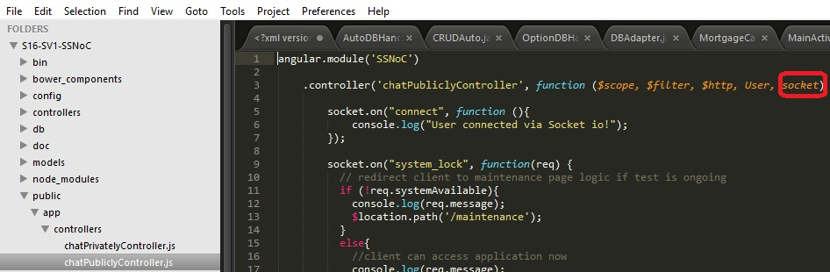
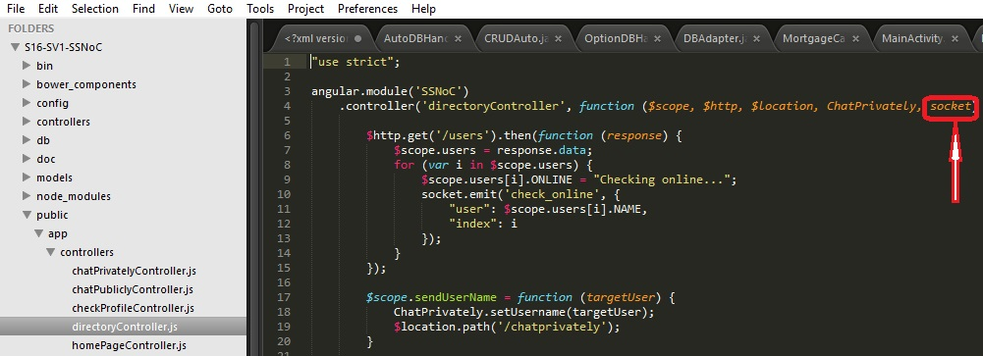
Design Implementation: Singleton
>> Used for Socket IO and Angularjs Services
chatPubliclyController.js
SocketService
directoryController.js

Slide 15
Design Implementation: Adapter
>> We used Adapter in the design of the SSNoC app database
>> Enabled us substitute production database with test database during testing and during Measure Performance use case

Slide 16
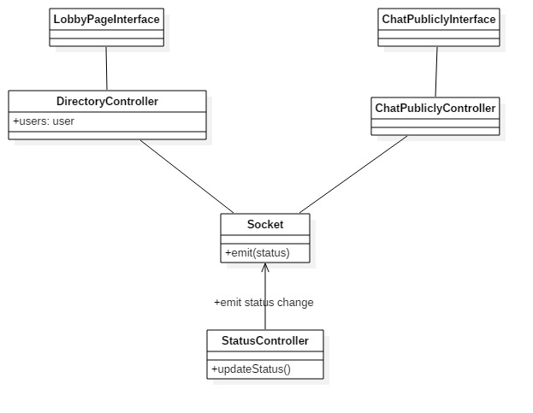
Design Implementation: Observer
>> The pattern upon which socket communication between server and client-side controllers thrives

Slide 17




Quality Attributes
One click! So easy!
Usability
Client-heavy architecture allows for more processing on client side
Ensuring that application performs with the same consistency across different range of devices
Energy Awareness
Cross-platform portability

Slide 18
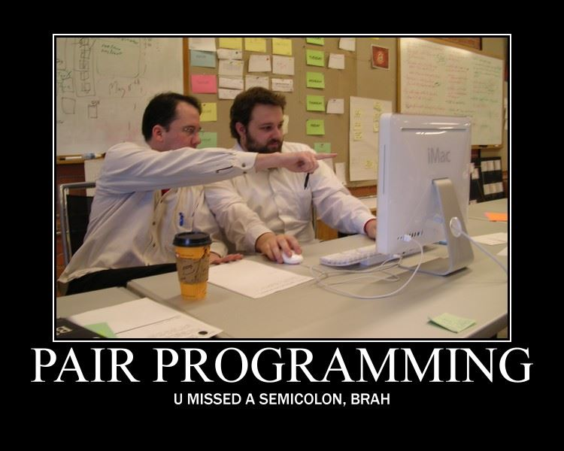
SE Practice
>> Pair Programing
Best way to learn
Driver-Navigator style
Know each other’s part in the project
Speed up the development
http://drlongnecker.com/gallery/48/friday-funnies-do-you-even-code-bro/i-have-no-idea-why
Notes:
Our Team implements some of the SE Practice we believe it is good to use and learn.
The first one of them is Pair programming. It is extremely helpful for the fact we have one of the best front end engineer in our group. With Shicheng’s help, we can focus on building new working blocks and he would be navigation when we meet any problem.
So it is quite fast to learn all the essentials because we are handling all kind of user case by ourselves.
We are also learning other’s work while we are doing the pair program.
And with this instruction, we rarely got stucked in our project and speed up our entire development

Slide 19
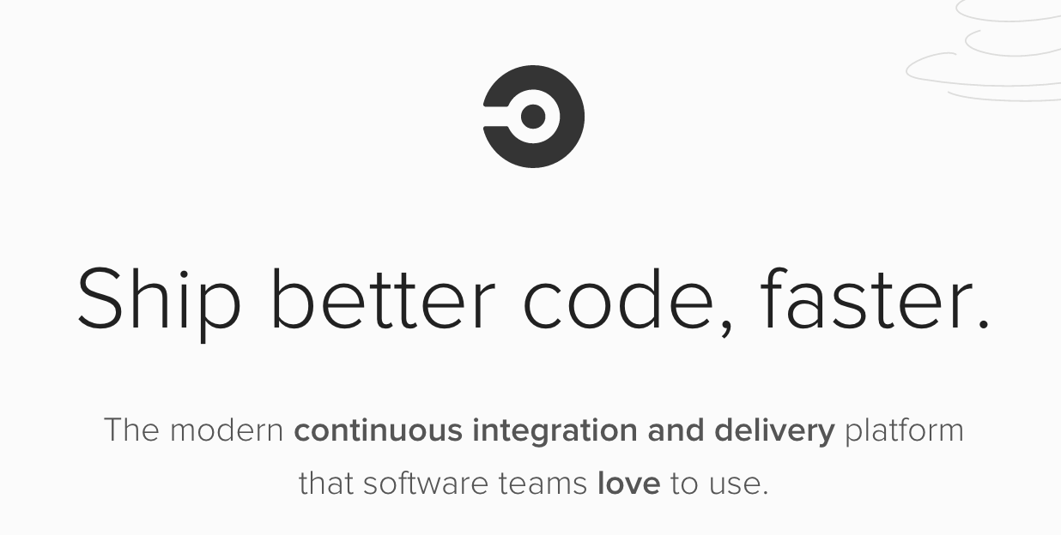
SE Practice
>> Continuous Integration
Make sure where is the problem
Automatically testing for each commit
https://circleci.com/
Notes:
We also found the continuous Integration fairly useful in the sense of frequent commit.
By using the circleci, we can have automatic mocha testing whenever there is a push to the github.
We can check the code coverage, build result, make sure when did we do wrong and take responsible to fix it in time.
The core idea of continous integration, commit frequently and fast are also some of the lessons we learnt from this project.

Slide 20

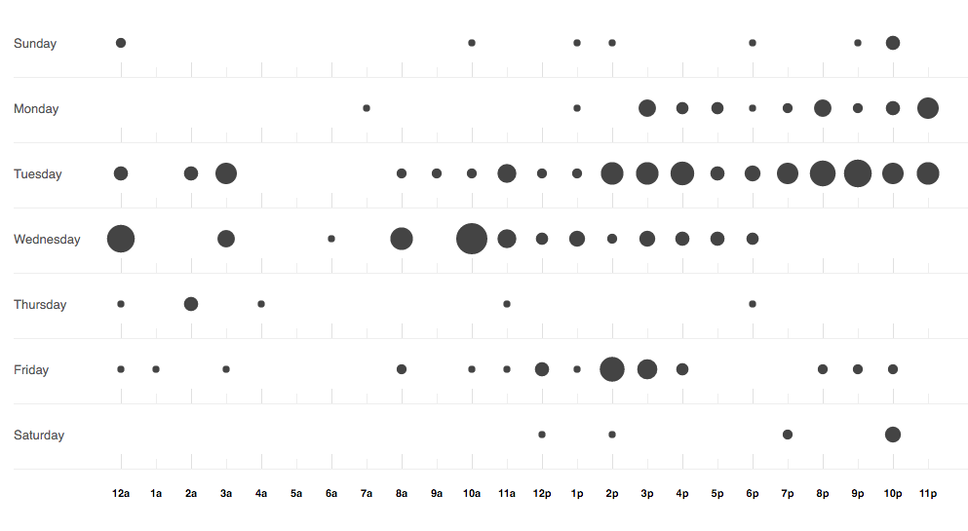

Lessons Learned
>> Commit frequently and commit with passing tests --->
https://xkcd.com/1597/
Notes:
There are 2 most important lessons we had and we would like to share with this class
First is the frequency we commit. As a team, we should alway be responsible for what our project.
So we commit very often in case of huge merge problems
At the same time, we try to make sure every commit we did are at least have one working test and have already pass the mocha test.
By this means, we can avoid huge merge conflict and evolve fast

Slide 21
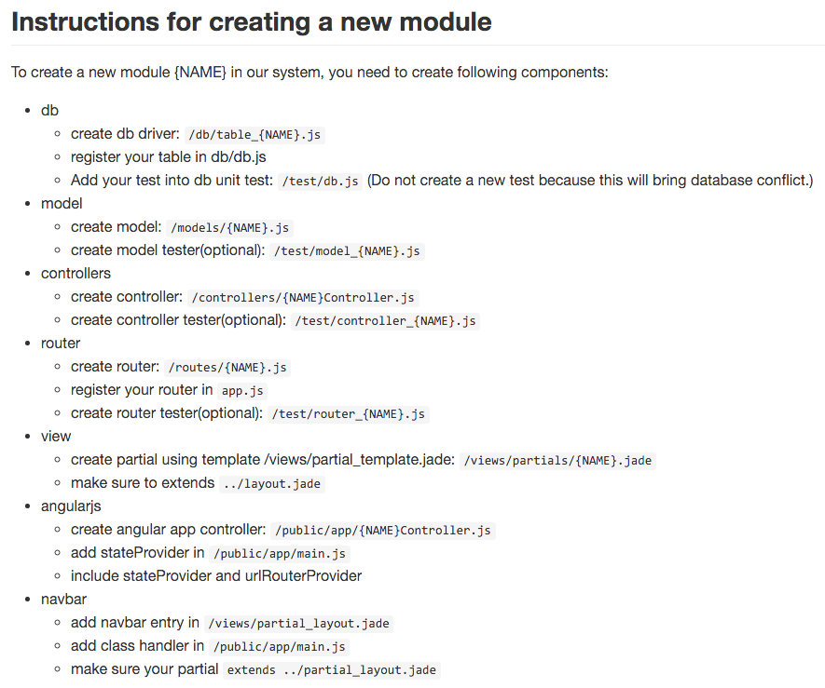
Lessons Learned
>> Follow team-wide standard
Template for user case
Fast building
Easy for debugging
Easy for testing
Notes:
It is also very nice to have a team wide standard to follow.
For our project, Angularjs can be very redundent in some case. And we found it some times difficult to build a new user case.
To have the project running, we just need to follow those naming convention and build the following files.
It is easier for us to build more user case in shorter time and easier to checking for bugs as well as testing

Slide 22
Thank you!

